Slide 1
Week 2 Workshop
Bootstrap 4

Slide 2
Agenda
Activity | Time
Get Prepared | 15 minutes
Weekly recap with Quiz Questions for each Task | 15 minutes
Task 1: Add form to the index.html file Review | 80 minutes
Task 2: Add image, badges Review | 40 minutes
BREAK | 30 minutes
Task 3: Add “Reserve a Table” button Review | 30 minutes
Sharing & Reviewing online | 15 minutes
Wrap-up | 15 minutes

Slide 3
Get prepared
Sit close to your classmate or Ask your instructor who you are partnered with for this assignment.
You will help one another
Please work on the index.html file
Follow the workshop instructions VERY CLOSELY

Slide 4
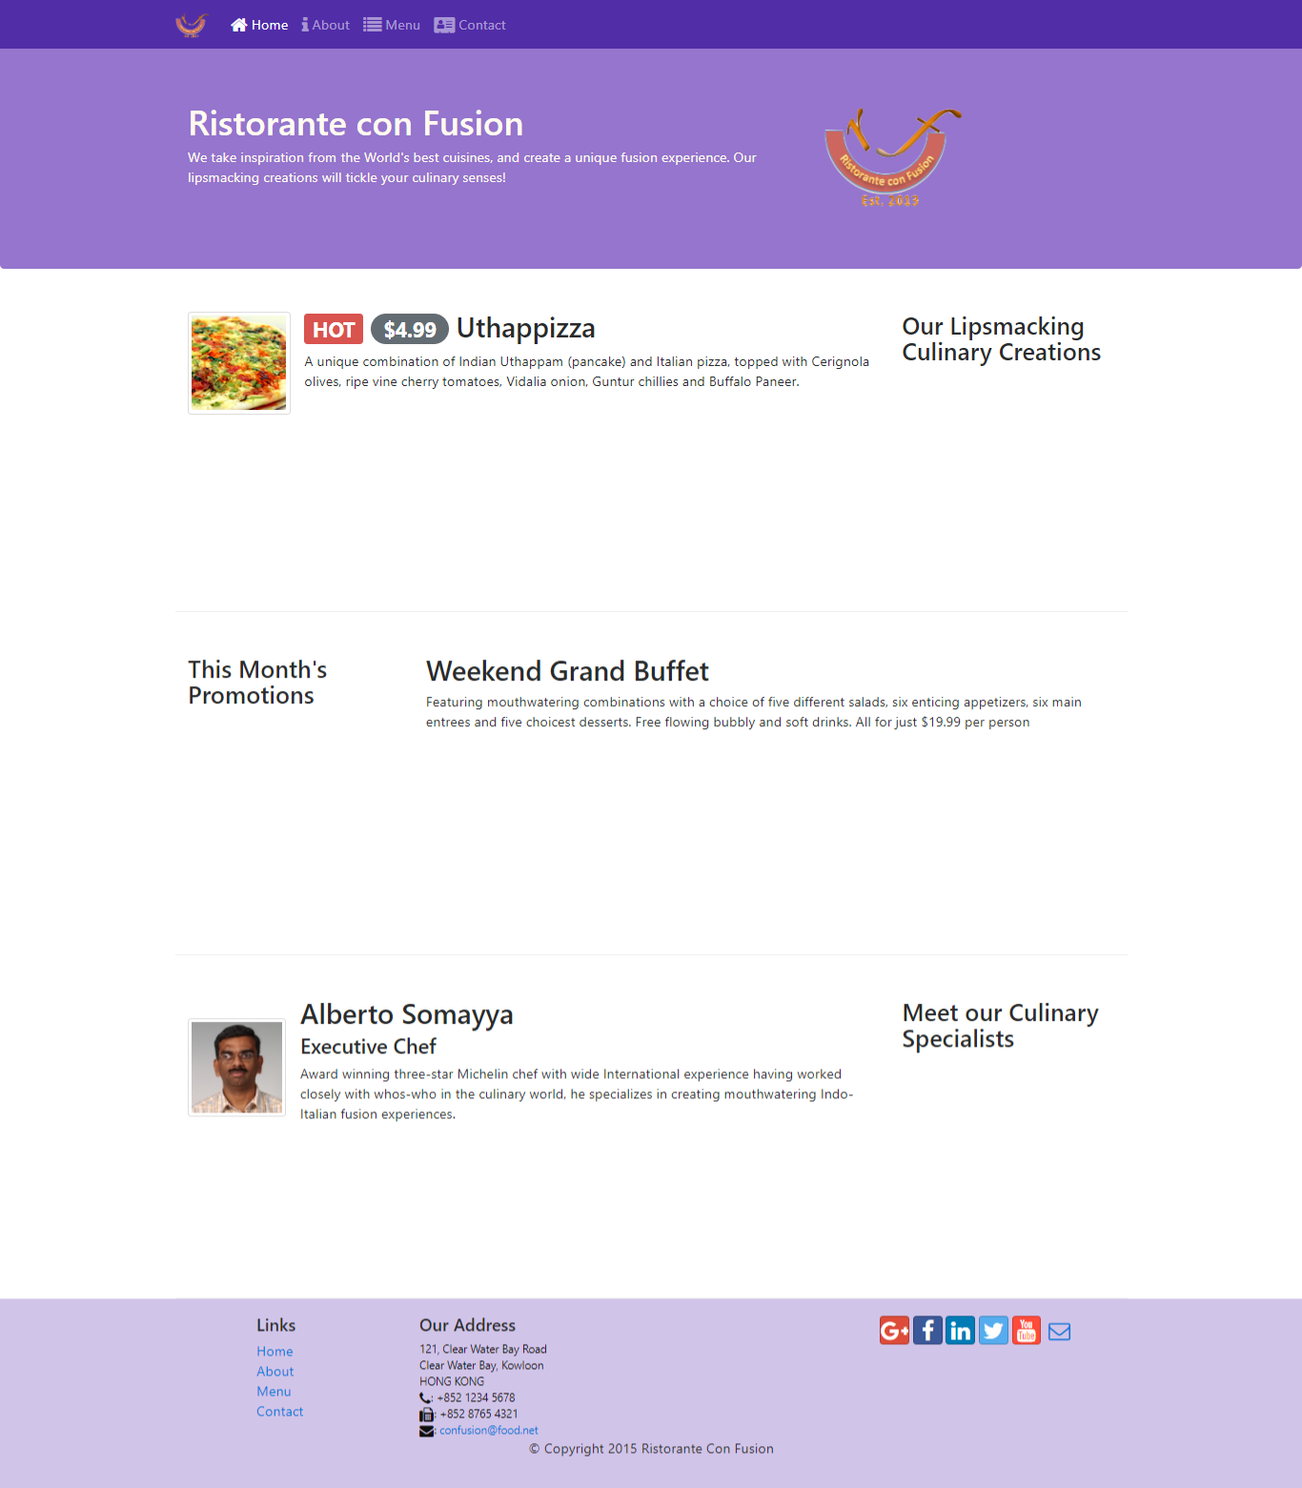
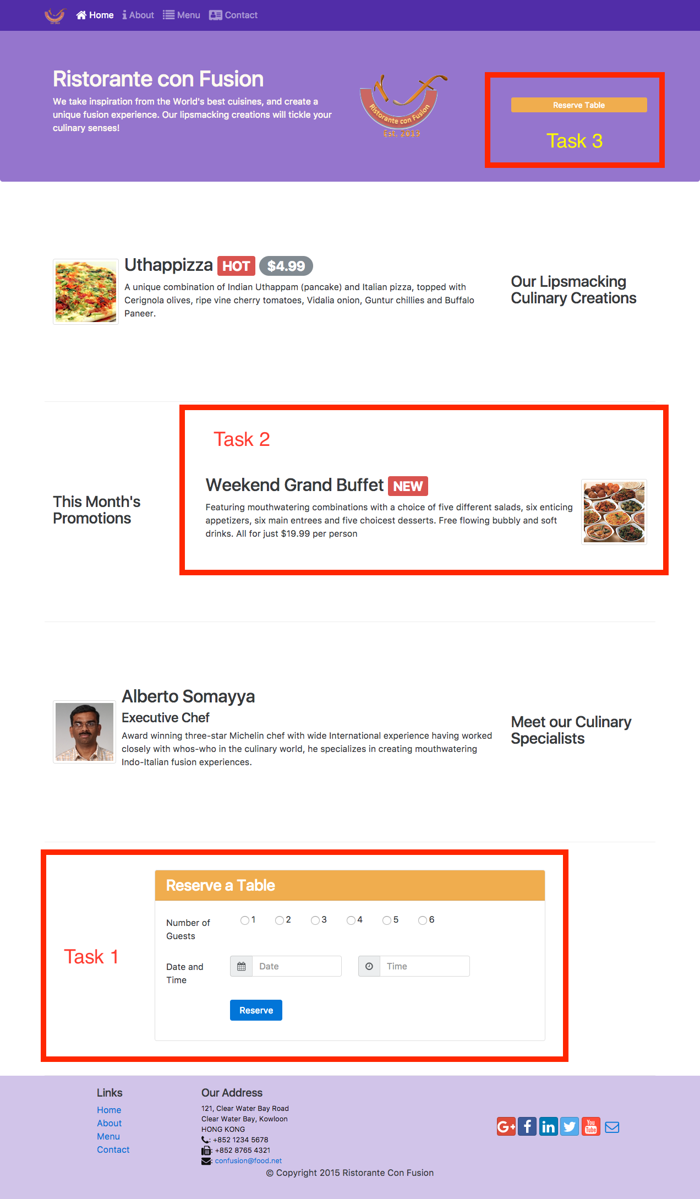
The 10 minutes rule [It’s actually 20 but for Workshop take 10]
"If you make no progress on a task after ten minutes of work, find someone to help you.“
https://www.linkedin.com/pulse/20-minute-rule-amber-hansford/

Slide 5
Resources
Links:
Assignment Details:
https://learn.nucamp.co/mod/page/view.php?id=197
All resources:
https://learn.nucamp.co/mod/page/view.php?id=146

Slide 6
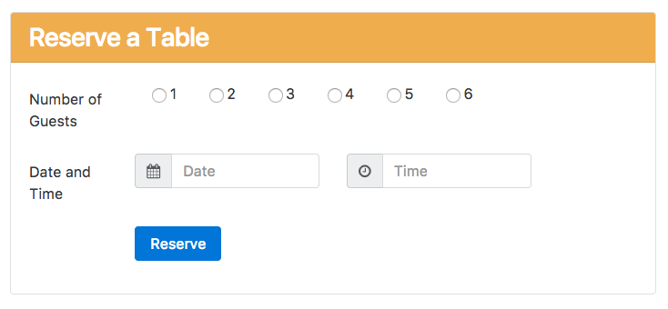
Weekly Recap with Quiz Questions [w.r.t Task 1]
Enlist the elements, containers hierarchically which you will need to design this form.
Resources:
https://learn.nucamp.co/mod/book/view.php?id=136&chapterid=170
https://learn.nucamp.co/mod/book/view.php?id=135&chapterid=202

Slide 7
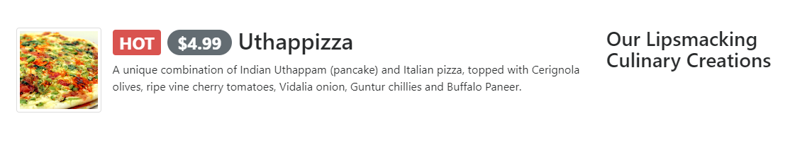
Weekly Recap with Quiz Questions [w.r.t Task 2]
State whether True/False[Refer Picture below]
1] The heading “Our Lipsmacking Culinary Creations” is flex-first.
2] The badge “Hot” is a warning badge.

Slide 8



Weekly Recap with Quiz Questions [with reference to Task 2]
The Badges got mixed up with the code. Match the Badges to equivalent line of code:
1]<h3>Meet our Culinary Specialists<span
class="badge badge-default">Default</span></h3>
2]<h3><span class="badge badge-default">
Default</span> Meet our Culinary Specialists</h3>
3]<h3><span class="badge badge-default">
Default</span>Meet our Culinary Specialists</h3>
Image 1
Image 2
Image 3

Slide 9
Weekly Recap with Quiz Questions [w.r.t Task 3]
html
What tag can we use instead of a button to navigate to the form?
Clue:
https://www.w3schools.com/tags/att_a_href.asp

Slide 10
At the end…
Submit you workshop files into the course at Assignment Week 2 Submission
Start with Week 3!

